Slide 1
Workload Distribution
DEA Group Project
https://www.flydubai.com/en/

Slide 2
Phoenix Airline Web
Home
Plan
Book
Experience
Sign Up / Login
Book a Flight
Contact
Footer
Holidays by Phonix
Fare Types
Covid-19 Info hub
Ways to Pay
Visas & Passports
Change Your bookin
Timetable
Flight Status
Connecting Flights
Book with a promo code
Car Rentals 15%
Global Offers
Book a flight
Flight + Hotel
Manage Booking
Chek in
Business Class
Economy Class
Entertainment
Wifi
Fly with Us
Business Class
Economy Class
Check-In Flights
Baggage
Partners
Passenger Services
FAQ’s
Travel Shops
Plan / Book / Experience / Flywith us/ Contact
Fare types ..
Connections
Airports
Travel Ideas
Route Map
Booking ..
Destinations
Business Class..
Flight Status
Holidays
Hotels
Car Rentals
Tours
Upgrade to business class
Sign up for news lestter
Ushani
Thiruni
Kalani Akka
Wasana
Lahiru Aiya
Lakshan

Slide 3
HOME

Slide 4
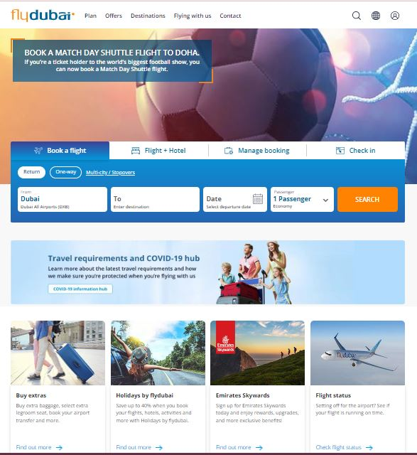

Slide 5
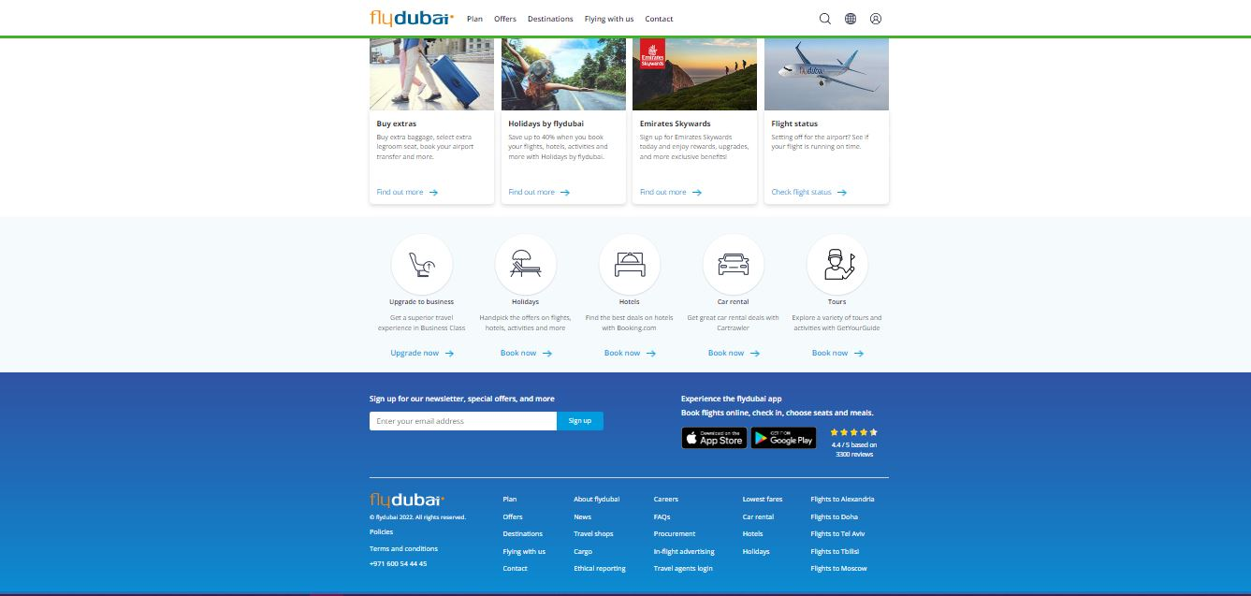

Slide 6
Plan

Slide 7
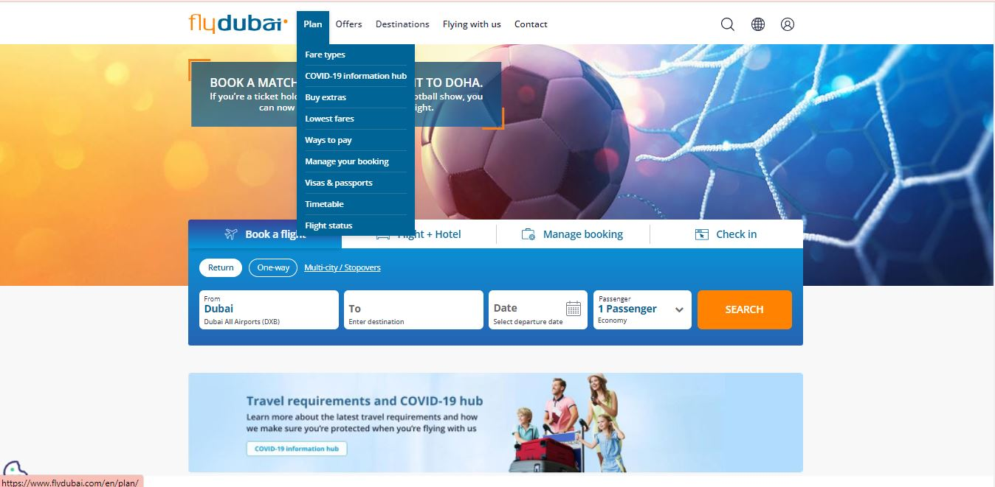

Slide 8
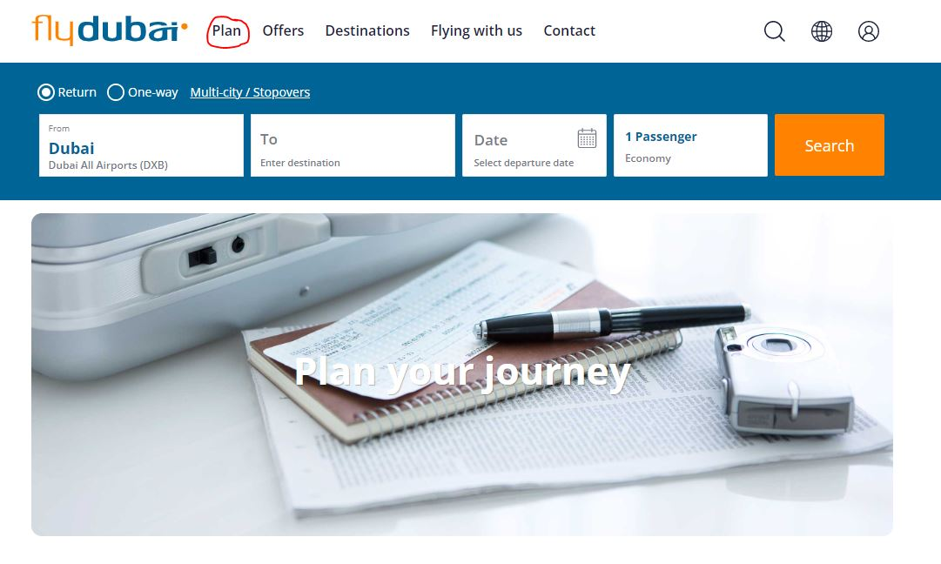

Slide 9
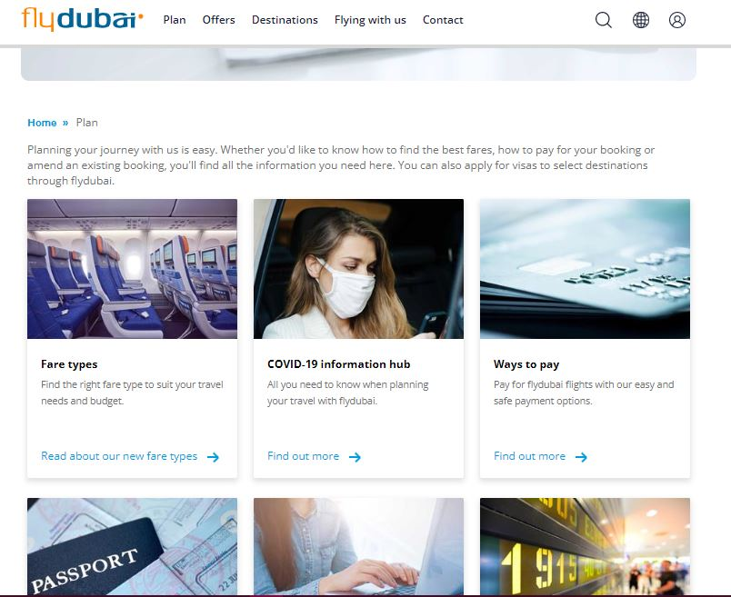

Slide 10
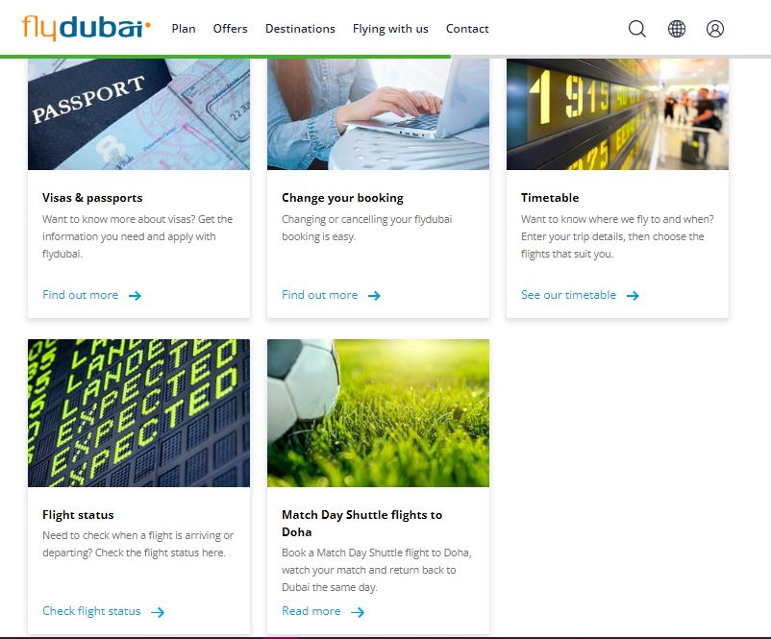

Slide 11
Book

Slide 13
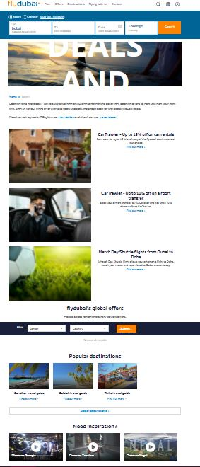
Add offers to Booking

Slide 14
Experience

Slide 15
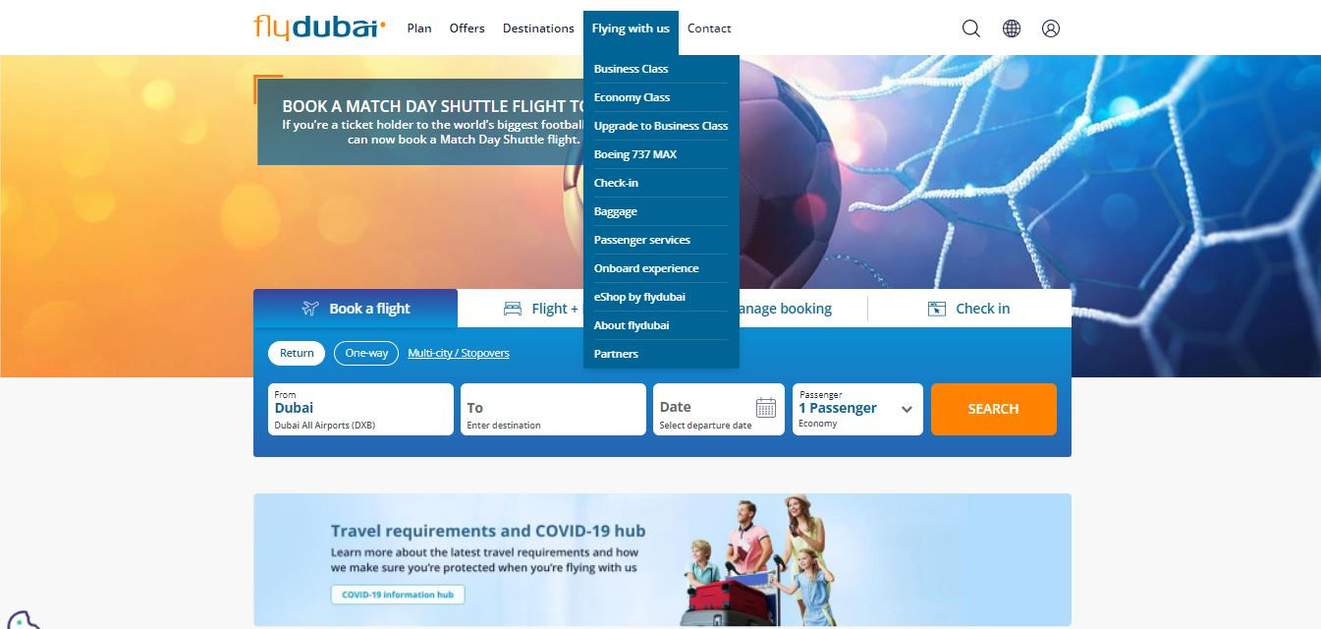

Slide 16
Fly with us

Slide 17
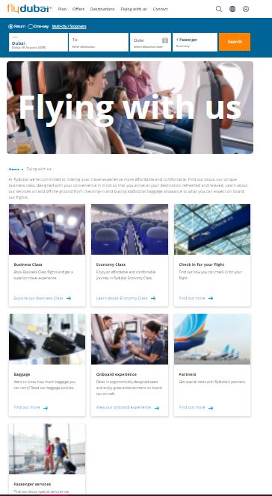

Slide 18
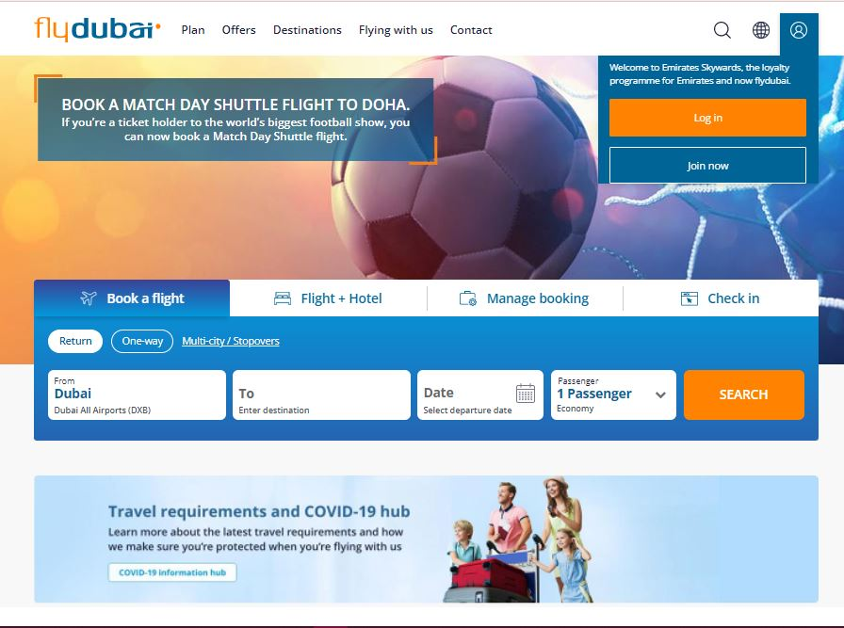
Sign up / LOGin

Slide 19
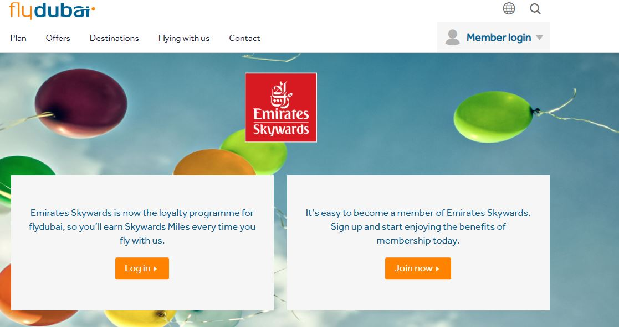

Slide 20
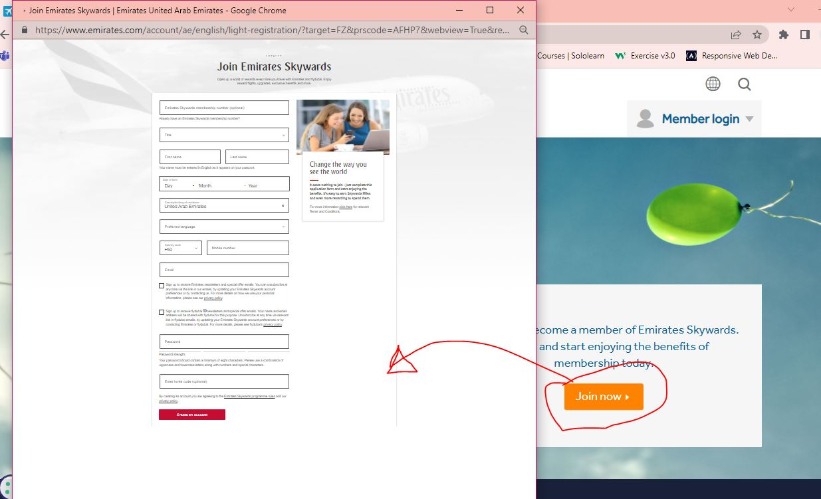

Slide 21
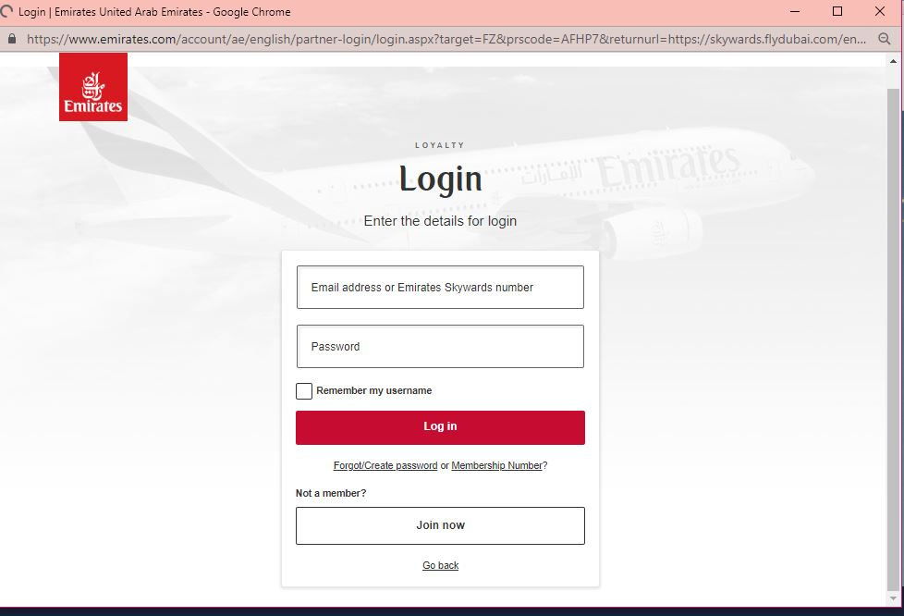

Slide 22
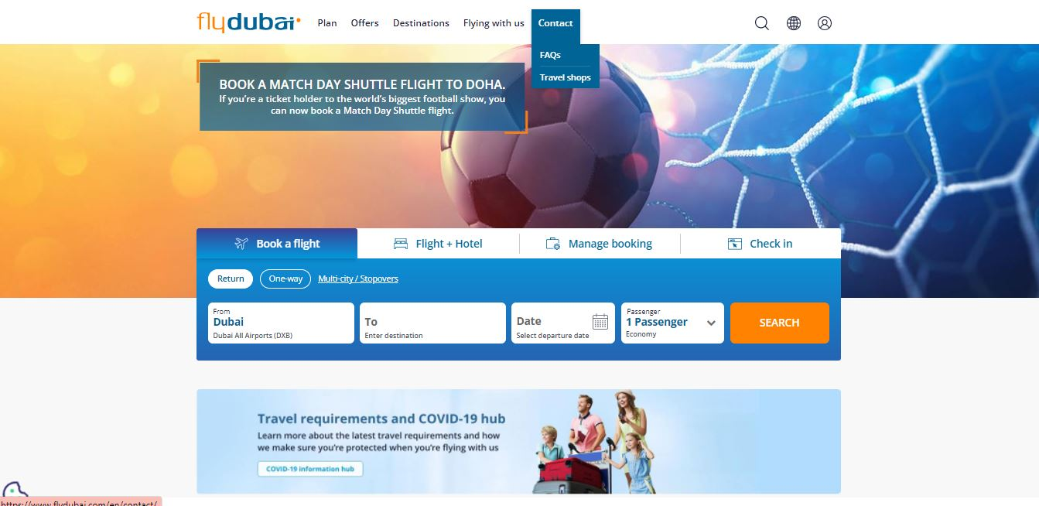
Contact

Slide 23
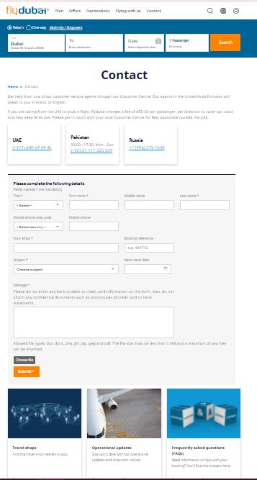

Slide 24
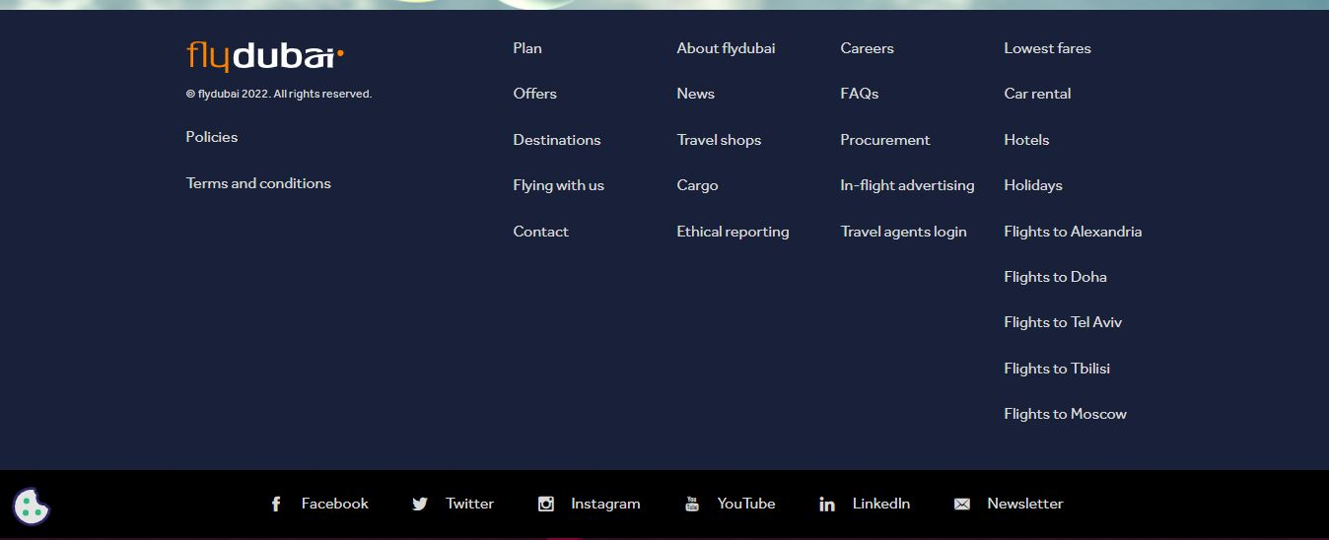
Footer

